Slide 1
ONLINE FOOD ordering system

Slide 2
ABSTRACT
The following project is based on the online food delivery concept with at wits to modify it to the hotel management level.Here we will tweak the algorithm to enhance stability of the online delivery system letting it perpetuate and resonate with the better functions of the system.
Here we will introduce various modules and QUICK SORT algorithm. We will also use some GUI for the project on a basic level to make the system more easy to understandand adding a more user friendly touch to it.

Slide 3
ABSTRACT
Our proposed system is an online food ordering system that enables ease for the customers. It overcomes the disadvantages of the traditional queuing system. Our proposed system is a medium to order online food hassle free from restaurants as well as mess service. This system improves the method of taking the order from customer. The online food ordering system sets up a food menu online and customers can easily place the order as per their wish. Also with a food menu, customers can easily track the orders.
This system also provides a feedback system in which user can rate the food items. Also, the proposed system can recommend hotels, food, based on the ratings given by the user, the hotel staff will be informed for the improvements along with the quality. The payment can be made online or pay-on-delivery system. For more secured ordering separate accounts are maintained for each user by providing them an ID and a password.

Slide 4
INTRODUCTION
Due to the advent of many online food ordering service system most people have stopped using the hotel’s restaurant and bars reducing the economic factor and inflow of money in the hotel as it is considered as one of the major financial inflows in the industry. Since the arrival of food apps such as Tomato and Twiggy the hotel industry have rendered in the influx of money hence making it very difficult to maintain and subside the business. Hence, this project will help owners to improve their income and build better relationships with the customers.
An online ordering system for Restaurants helps enhance the customer-restaurant relationship by providing end to end Customer Relationship Management (CRM) system. It provides a complete sales dashboard with information about new/active/canceled orders, lifetime sales details, etc.
It also comes with an order management system that streamlines the entire ordering process starting from order placement to final delivery.

Slide 5
INTRODUCTION
Such software are also equipped with GPS systems that help you capture the entire address that in turn ensure timely and fast deliveries. The professed meat ordering system sets up a food menu online and customers can easily place the order as per they like. Also with a food menu, online customers can easily track the orders. The management maintains customers database, and improve food delivery service. The Restaurant management systems motivates us to develop the system.
The system/interface will take input from the user. The major attributes that will give input to the data set are: name, address, email-Id, mobile no, other personal related values, etc. The output will include user/customer’s Order, Bill, Feedback and Payment options. Initially there will be 10 to 12 restaurants and mess services considered inside 2 to 3 areas.
The reason why to choose this project is the idea behind project that is to solve problem of people which they are facing when they shift to different city. The system is not only for user but also for provider who provides food service. This system is for making efficient communication between consumer and producer of the food system which will then leads to the ideal and effective system

Slide 6
PROJECT SCOPE
The above system helps in the following ways:
a. Reduce time between order instructions and improve management.
b. Helps in economic and financial factors of the hotel.
c. Helps in building better relationships with customers.
d. Means to compete with only delivery sites on equal grounds.
e. Modernization and uplifting means for a organization.

Slide 7
SOFTWARE REQUIREMENTS
FRONT END
HTML
CSS
JAVASCRIPT
BACKEND
XAMAPP
PHP
MY SQL

Slide 8
MODULES COMPLETED
We have completed six modules
1st is registration page: containing username, name, password and phone no.
2nd is log in page: After registration go for login by username and password
3rd is Order food page which contain food to order, price per quantity and quantity you want to order
4th is order history page where customer can see his order history
5th is comment page where customer can give his/her feedback
6th is edit details page where customer can edit his/her details

Slide 9
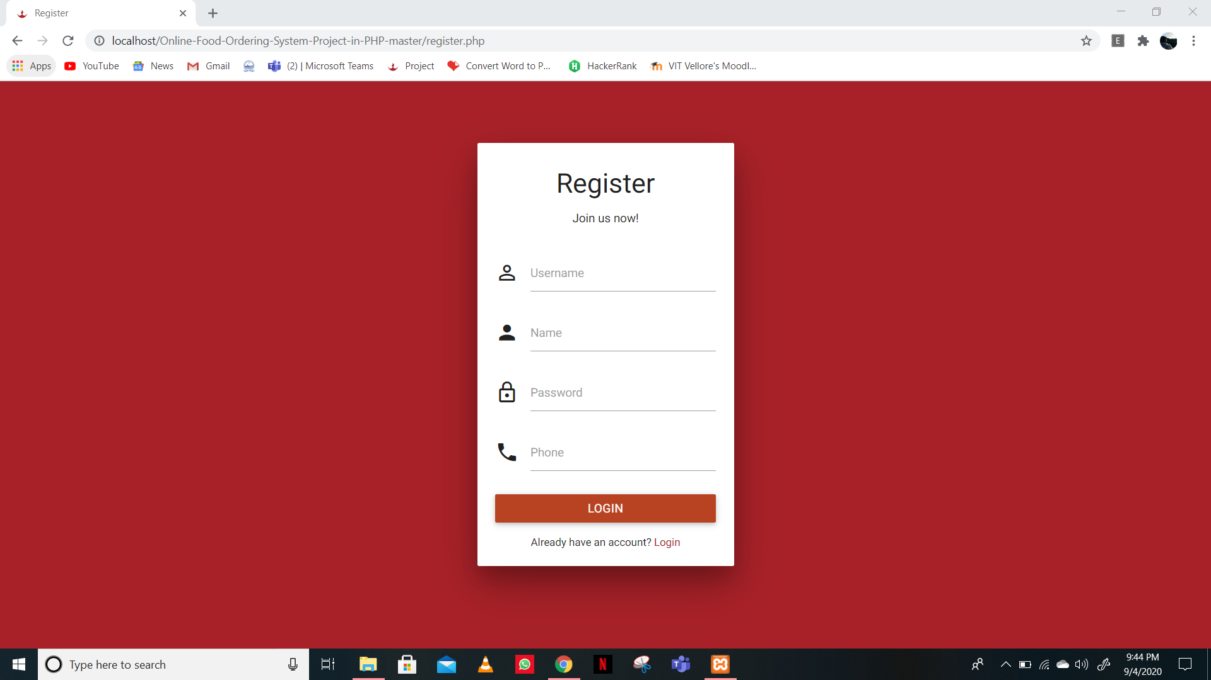
Screenshot of modules

Slide 10
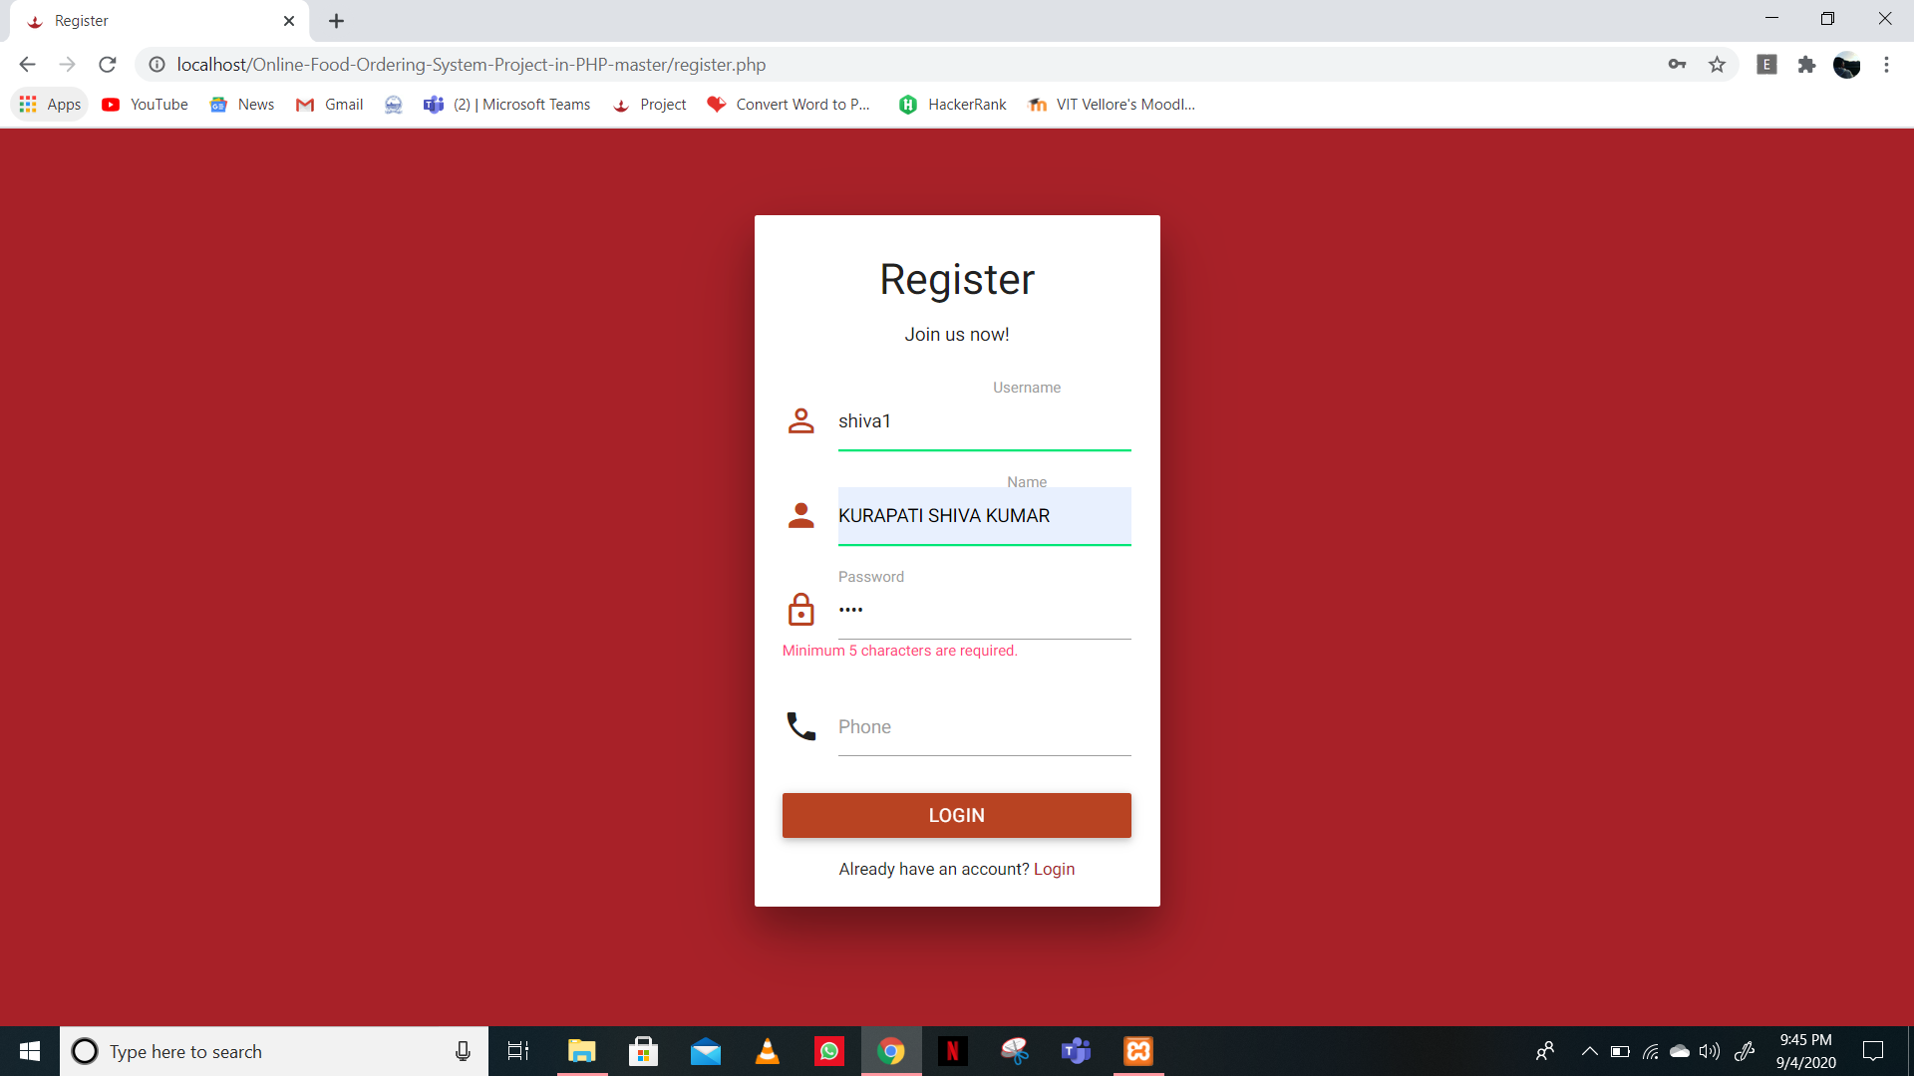
Screenshot of modules

Slide 11
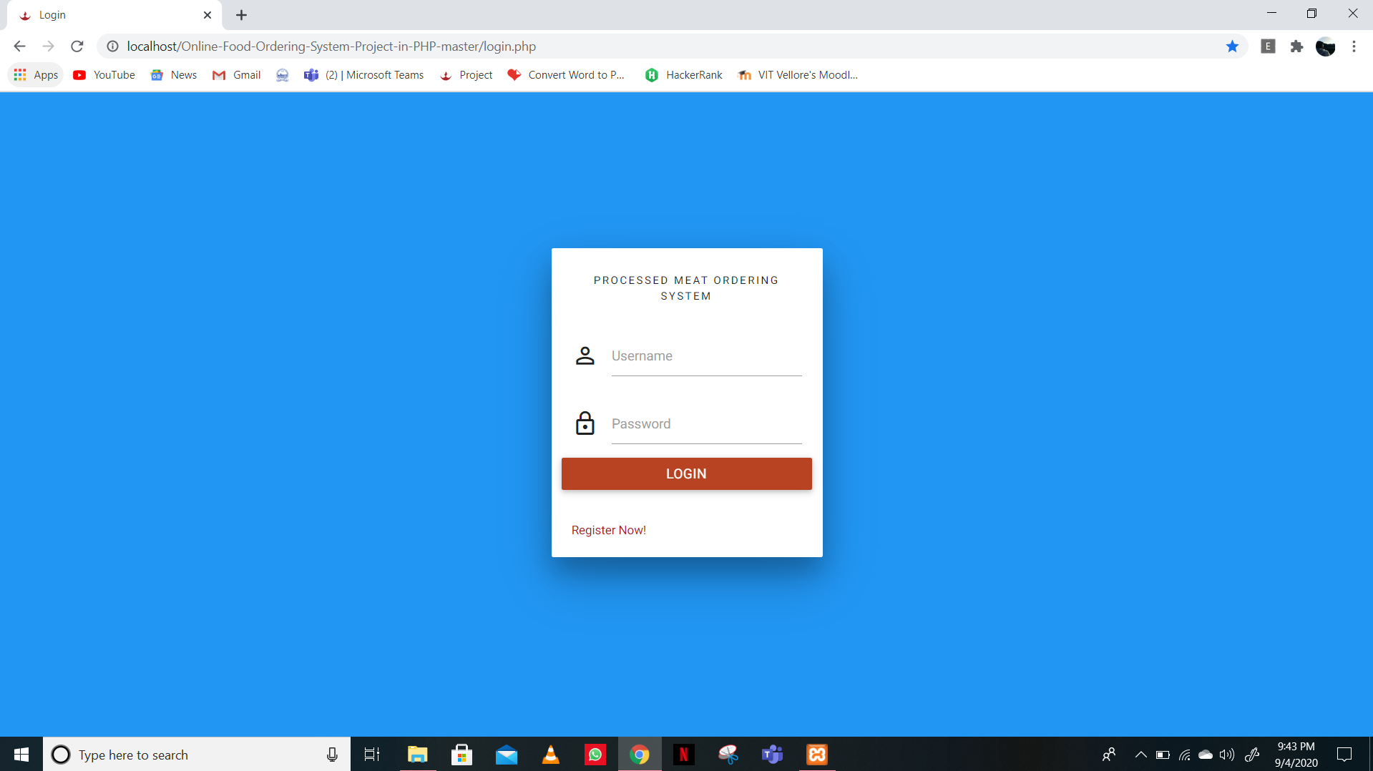
Screenshot of modules

Slide 12
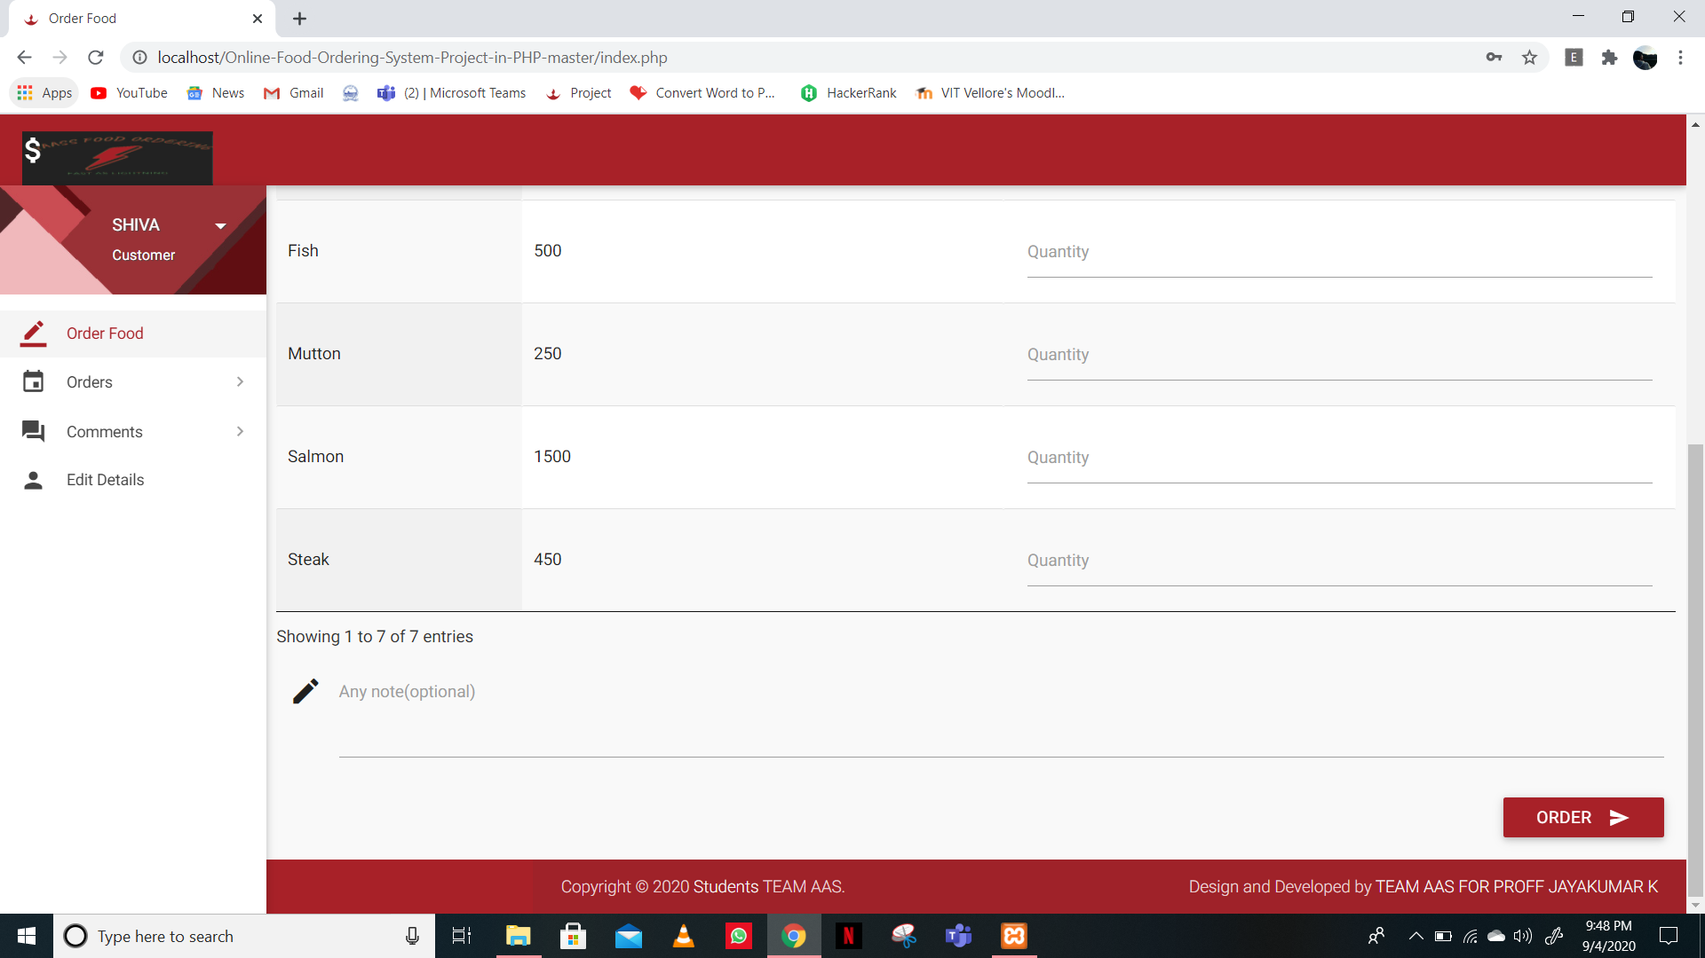
Screenshot of modules

Slide 13
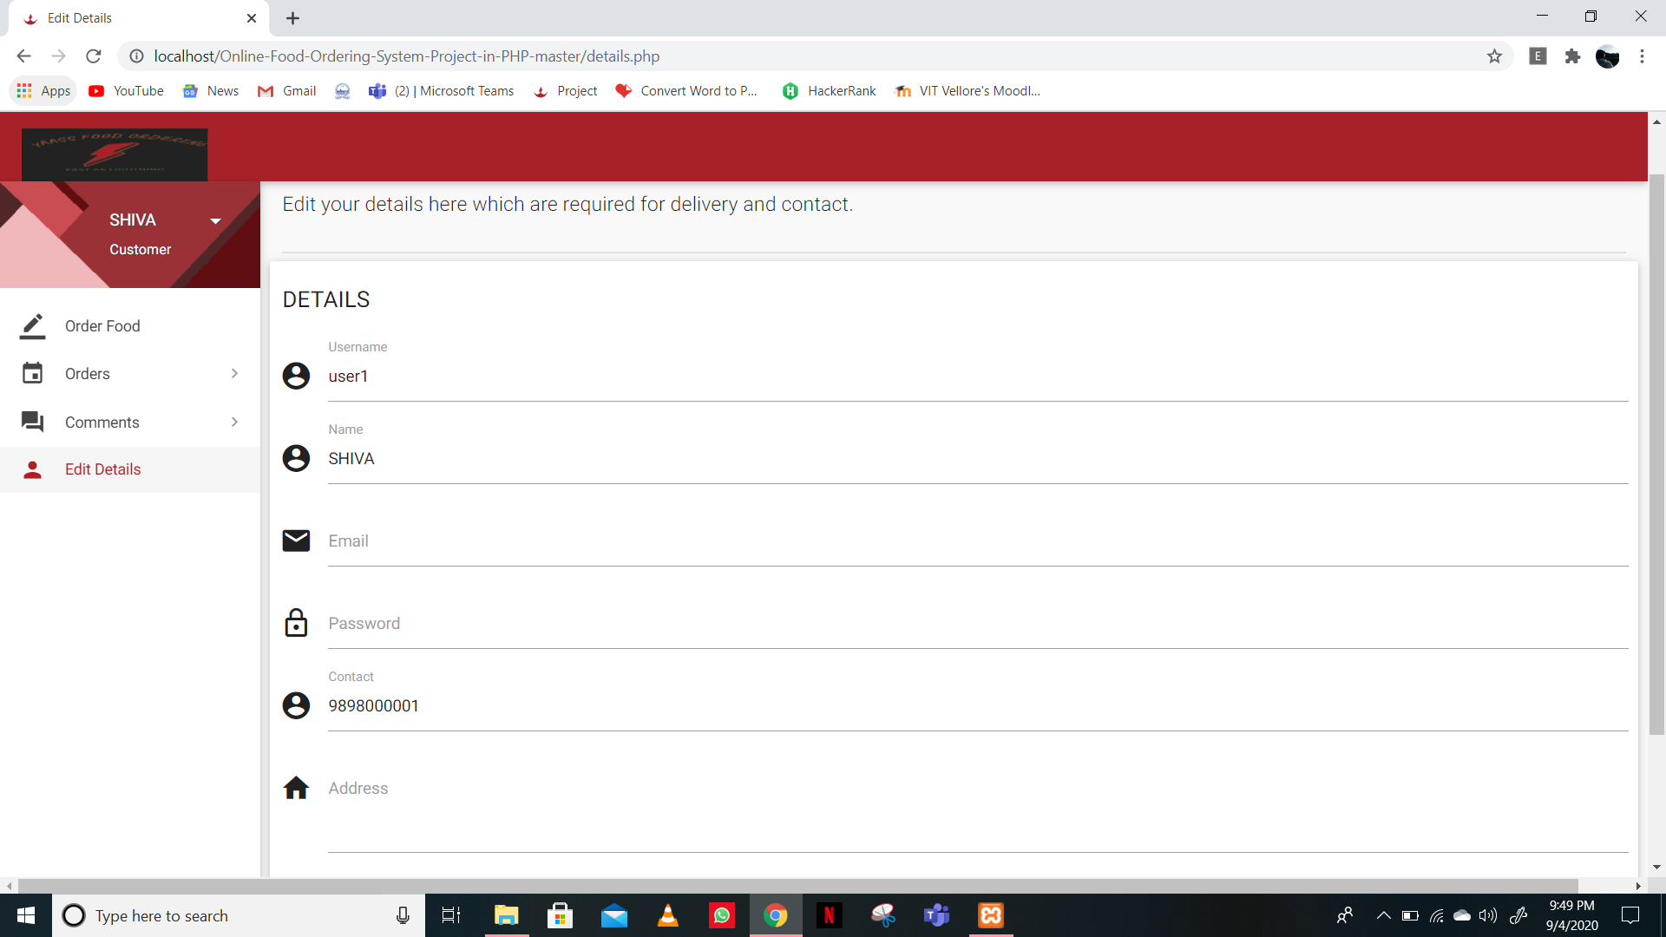
Screenshot of modules

Slide 14
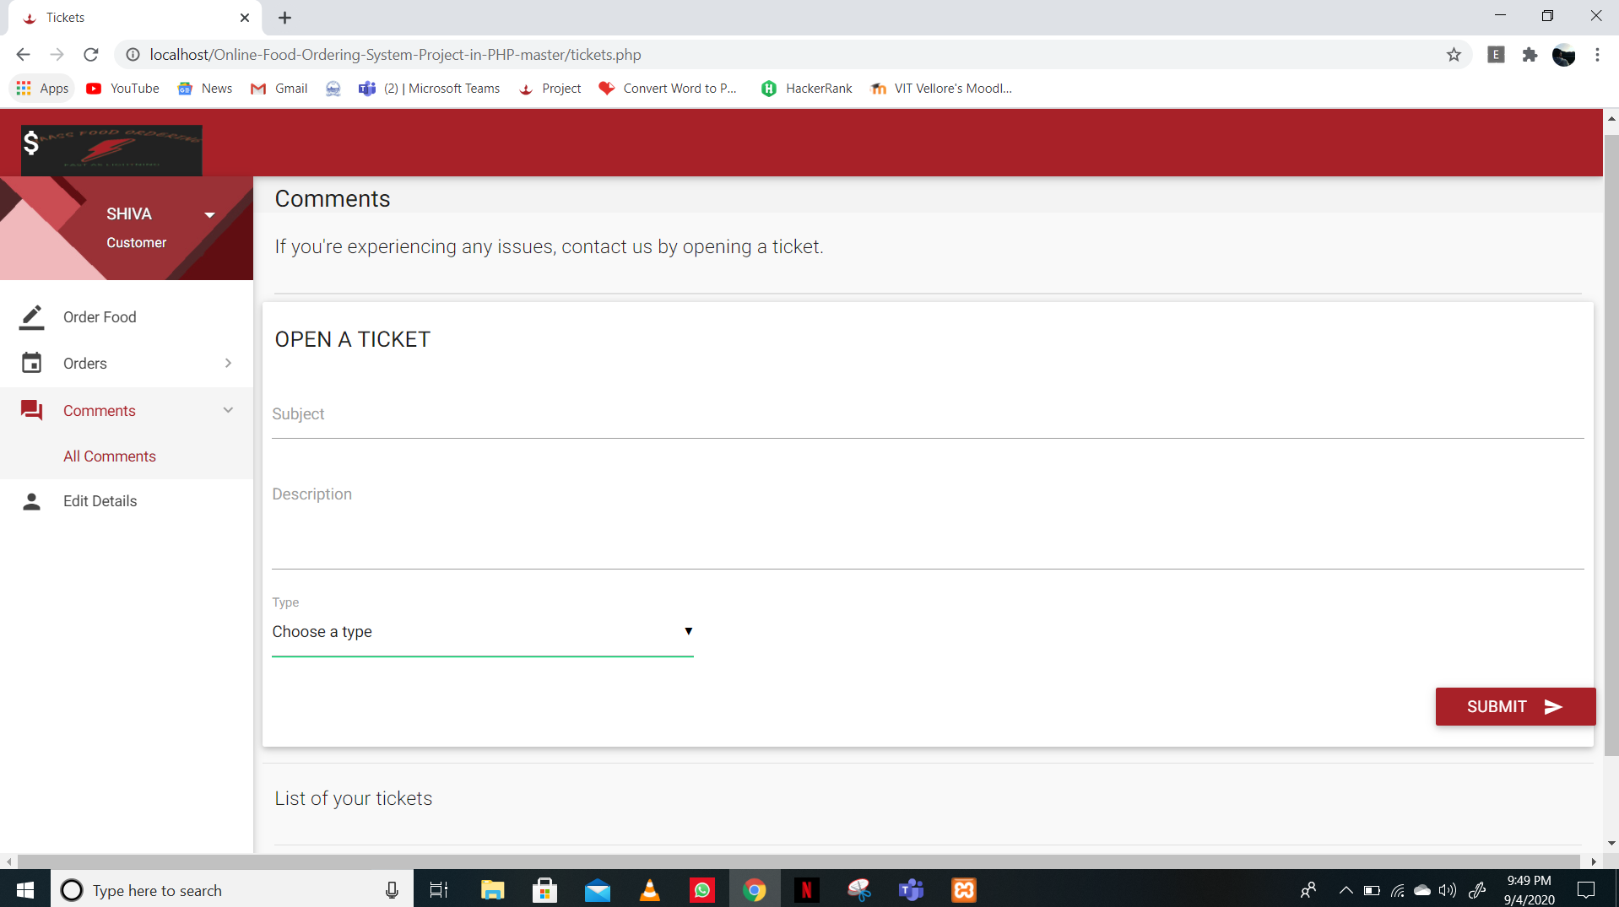
Screenshot of modules

Slide 15
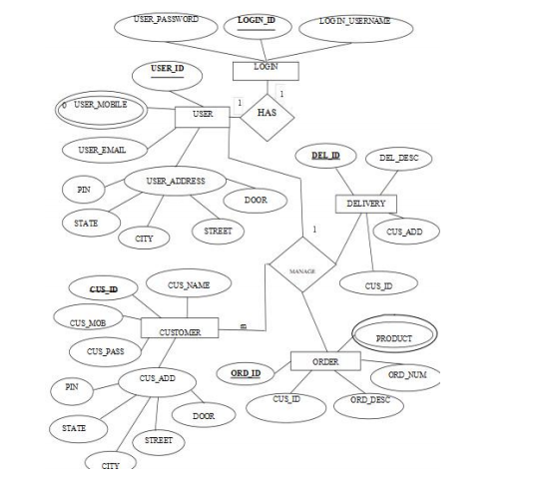
ER DIAGRAM

Slide 16
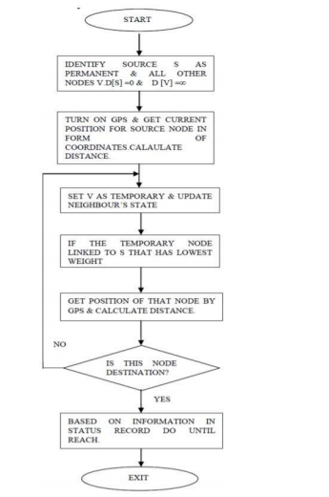
Flowchart :

Slide 17
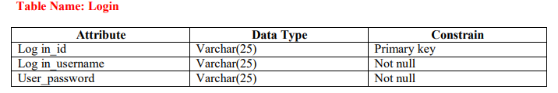
TABLES AND CONSTRAINTS

Slide 18
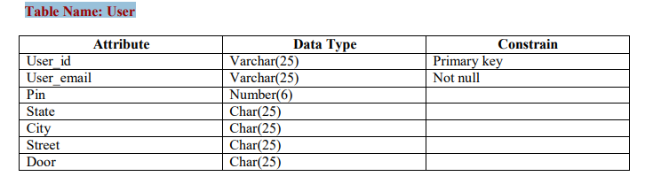
Table Name: User

Slide 19
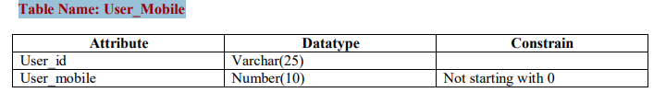
Table Name: User_Mobile

Slide 20
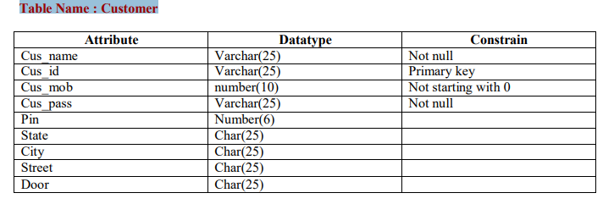
Table Name : Customer

Slide 21
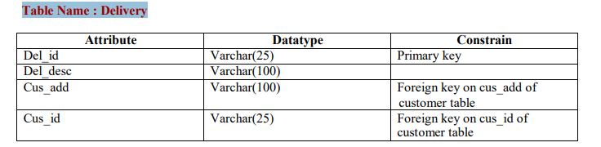
Table Name : Delivery

Slide 22
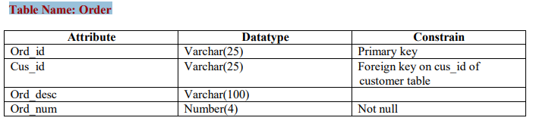
Table Name: Order

Slide 23
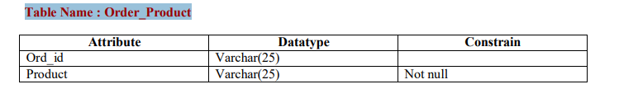
Table Name : Order_Product

Slide 24
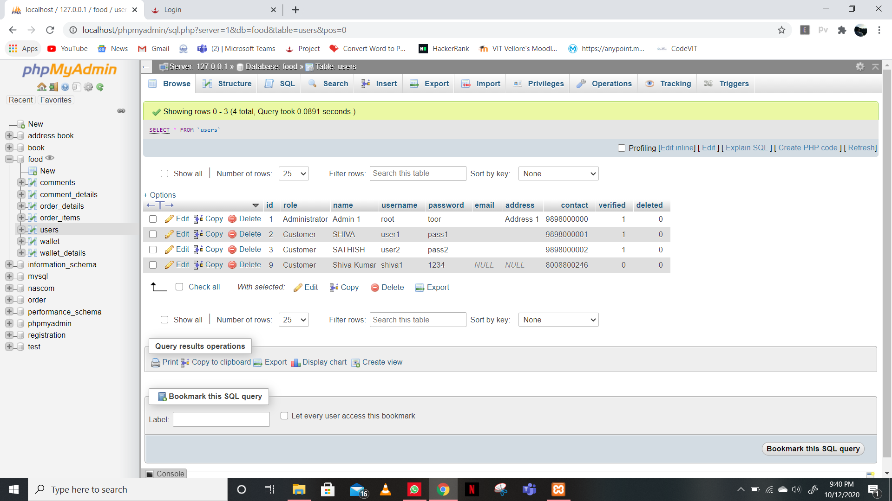
OUTPUT SCREENSHOT: USERS

Slide 25
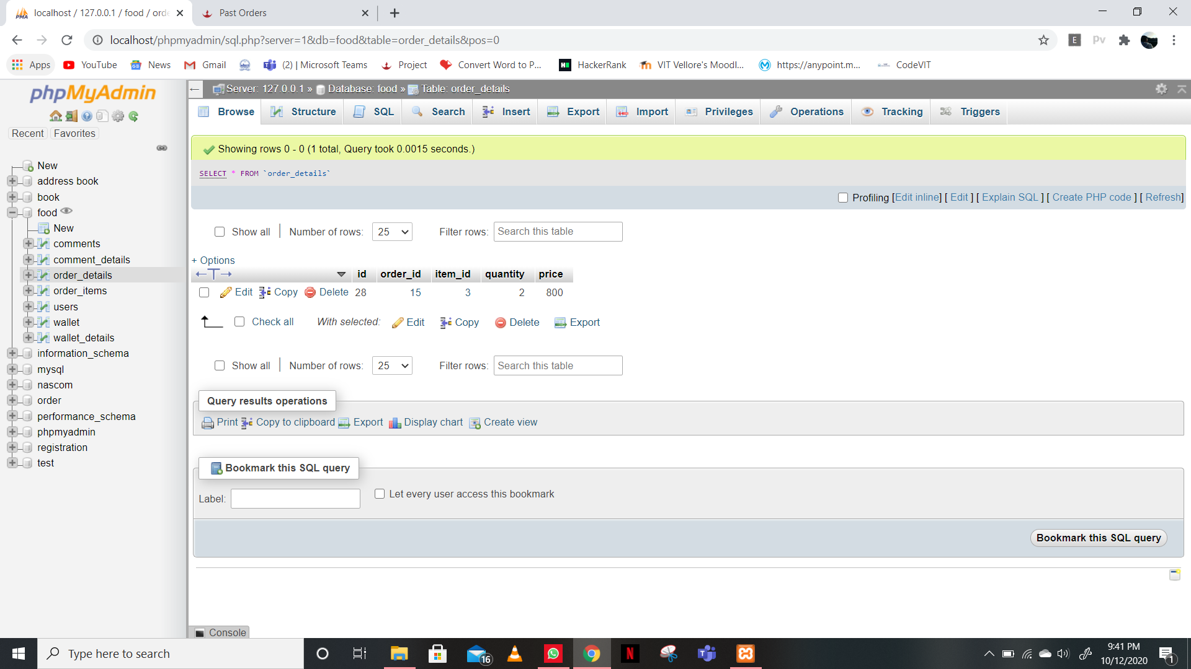
ORDERS

Slide 26
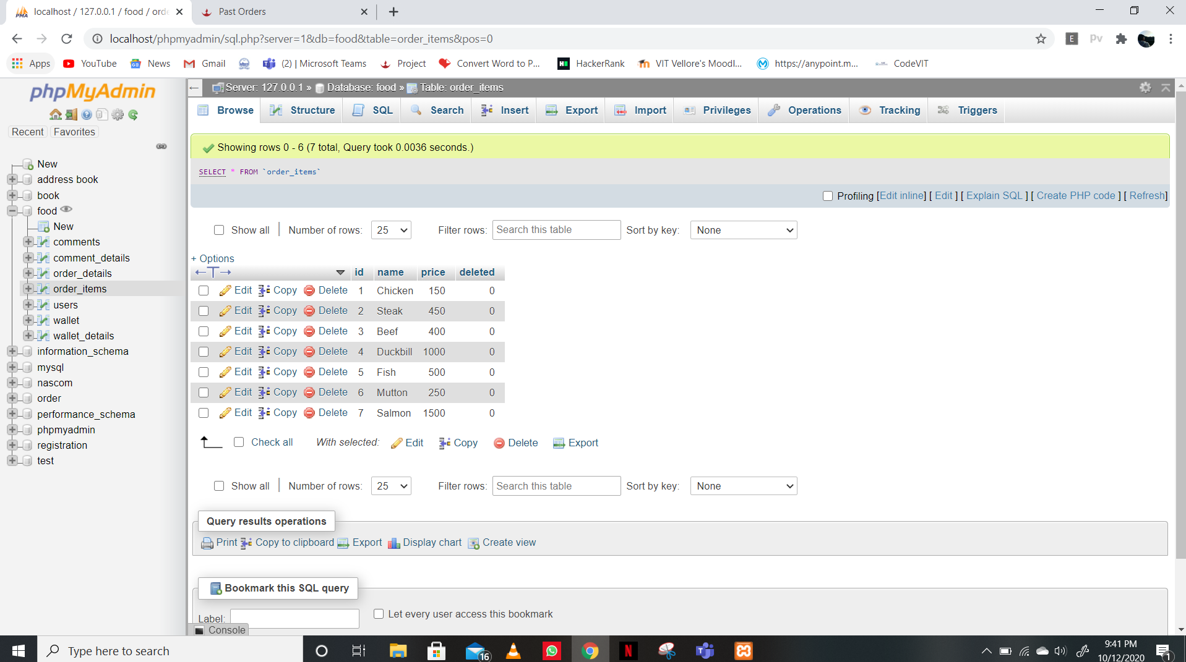
ORDER ITEMS

Slide 27
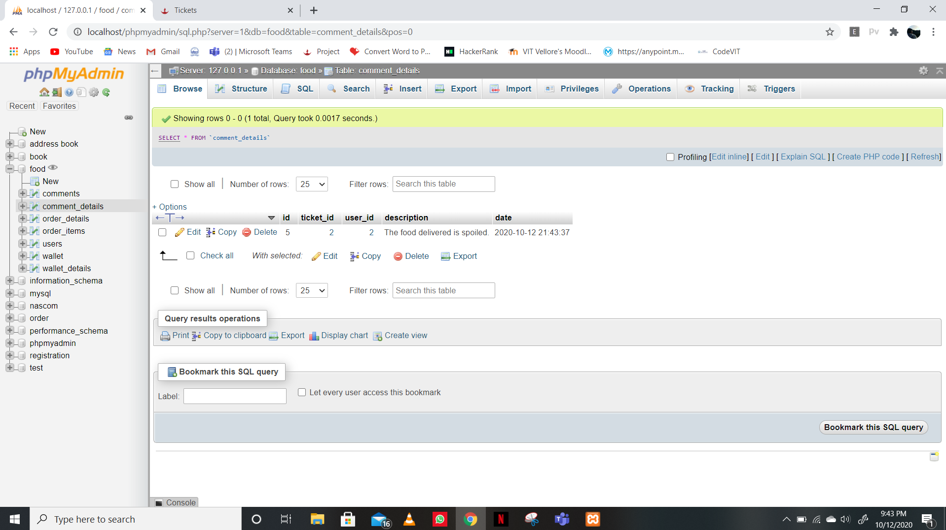
COMMENTS

Slide 28
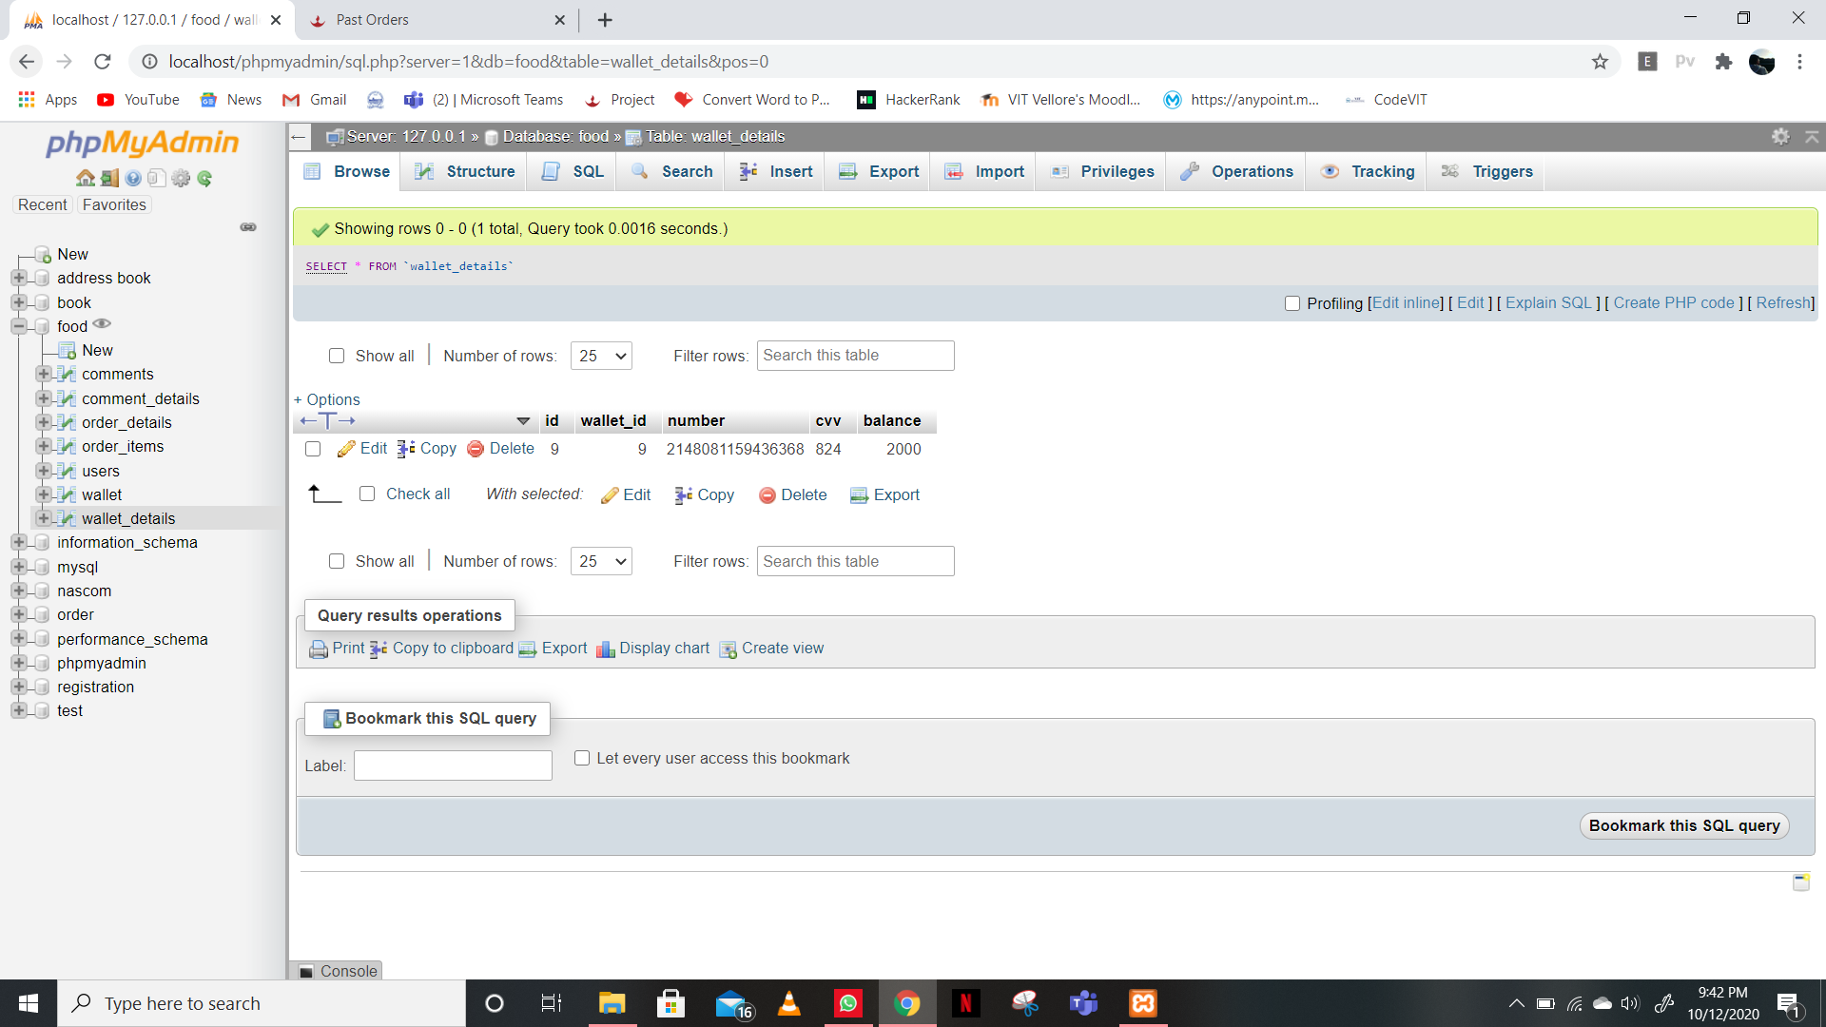
WALLET DETAILS

